Slide 1
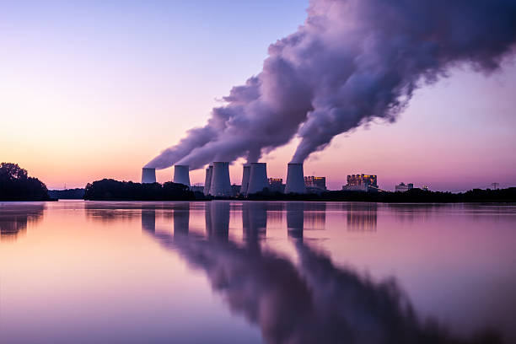
Air Quality Forecasting (CO2 Emission)
Group – 01
Vishal Sathe
Subin Nair
Nithin M
Pravin Chandel
Purva Kaiwart
Bhaskar Subbiah
Kishore yj
Mentor By
Adhvaith Sir

Slide 2
Business Objective: To forecast Co2 levels for an organization so that the organization can follow government norms with respect to Co2 emission levels.
Data Set Details:
Time parameter and levels of Co2 emission

Slide 3
Flow Chart
Dataset
Data Analysis
Splitting Data into Train and Test
Model Building
Deployment

Slide 4
Dataset
Shape of dataset is 215 rows and 2 columns.
Data-Type of Dataset is in Float.
There are no null values in the data.
There’s about no duplicates in the data.

Slide 5
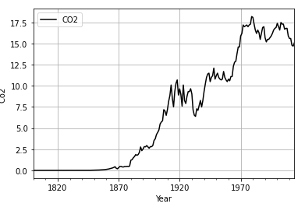
Analyzing Data With Graphs
In lineplot shows that C02 emission over the period of time is increasing therefore data is showing exponential trend but no seasonality is present in data.

Slide 6
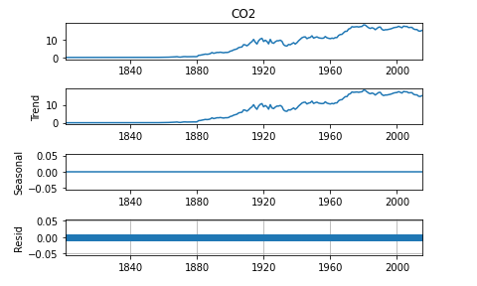
Seasonal Demoposition
Average is not constant for the co2 emission over the period of time
There is a trend followed by data which is of exponential type
Seasonality is not present in the data
There are no residuals

Slide 7
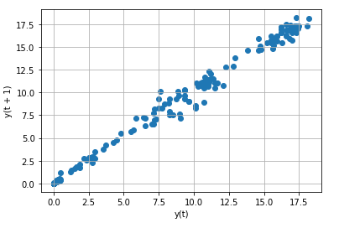
Lag Plot
Lag plots shows that there is positive liner relation between variable and its own lag variable

Slide 8
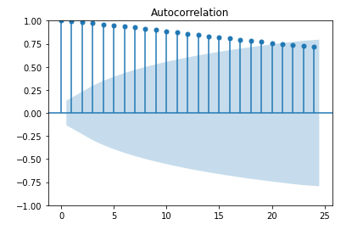
Autocorrelation
The graph we can examine that nearest time lag has good autocorrelation but as we reach time period which are far away the autocorrelation is decreasing.

Slide 9
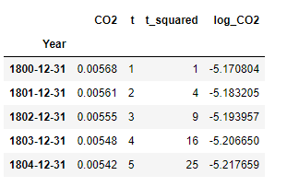
Modifying the data
Including columns : "t"-time,"t_square"-time square,"log_co2"-log of Co2

Slide 10
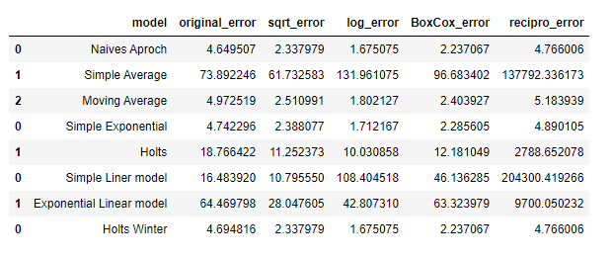
Model Building
Naive Aproch , Simple Exponential and Holts Winter method has given least error with Log Transformation .
As Naive Aproch work well when data set contain less variance but that's not a case with our data ,
our data have high variance therefore we did not gone with it and decided to go with Holts Winter Method.

Slide 11
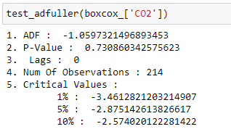
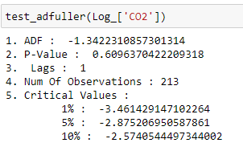
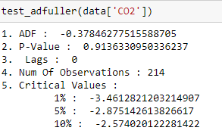
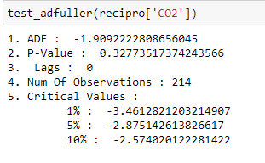
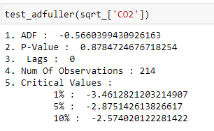
Arima
Function for adfuller test
From adfuller test we came to know that reciprocal Transformation is giving least p_values so we will build arima model on Reciprocal Transformation

Slide 12
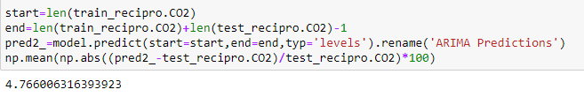
ARIMA can't outperform Holts Winter Method therefore our final model will be build on Holts Winter Method

Slide 13
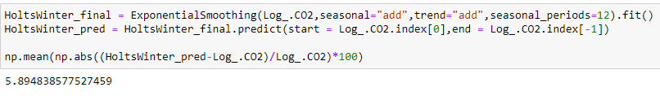
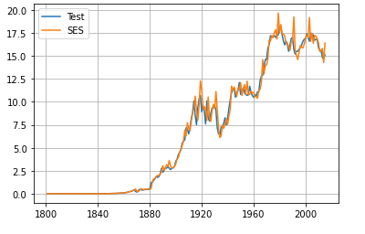
Final model with Holts Winter Method

Slide 14
Model Deployment
Model deployment using streamlet

Slide 15
Challenges Faced In Project
The Data we get have least 200 years of Co2 emission information, but in the initial years there was no considerable emission.
So we had to split the data in part to feed the optimum information to model.
There was trend in our data so we had to use differencing to remove thrend effect.

Slide 16
Thank You…

